Slide 1
Regular Expressions

Slide 2
Regular Expressions
Notation to specify a language
  Declarative
  Sort of like a programming language.
    Fundamental in some languages like perl and applications like grep or lex
  Capable of describing the same thing as a NFA
    The two are actually equivalent, so RE = NFA = DFA
  We can define an algebra for regular expressions

Slide 3
Algebra for Languages
Previously we discussed these operators:
  Union
  Concatenation
  Kleene Star

Slide 4
Definition of a Regular Expression
R is a regular expression if it is:
  a for some a in the alphabet ∑, standing for the language {a}
  ε, standing for the language {ε}
  Ø, standing for the empty language
  R₁+R₂ where R₁ and R₂ are regular expressions, and + signifies union (sometimes | is used)
  R₁R₂ where R₁ and R₂ are regular expressions and this signifies concatenation
  R* where R is a regular expression and signifies closure
  (R) where R is a regular expression, then a parenthesized R is also a regular expression
This definition may seem circular, but 1-3 form the basis
Precedence: Parentheses have the highest precedence, followed by *, concatenation, and then union.

Slide 5
RE Examples
L(001) = {001}
L(0+10*) = { 0, 1, 10, 100, 1000, 10000, … }
L(0*10*) = {1, 01, 10, 010, 0010, …} i.e. {w | w has exactly a single 1}
L(∑∑)* = {w | w is a string of even length}
L((0(0+1))*) = { ε, 00, 01, 0000, 0001, 0100, 0101, …}
L((0+ε)(1+ ε)) = {ε, 0, 1, 01}
L(1Ø) = Ø ; concatenating the empty set to any set yields the empty set.
Rε = R
R+Ø = R
Note that R+ε may or may not equal R (we are adding ε to the language)
Note that RØ will only equal R if R itself is the empty set.

Slide 6
RE Exercise
Exercise: Write a regular expression for the set of strings that contains an even number of 1’s over ∑={0,1}. Treat zero 1’s as an even number.
Notes:
E=(10*1+0)* E=(10*1)+0)(0+10*1)*

Slide 7
Equivalence of FA and RE
Finite Automata and Regular Expressions are equivalent. To show this:
  Show we can express a DFA as an equivalent RE
  Show we can express a RE as an ε-NFA. Since the ε-NFA can be converted to a DFA and the DFA to an NFA, then RE will be equivalent to all the automata we have described.

Slide 8
Turning a DFA into a RE
Theorem: If L=L(A) for some DFA A, then there is a regular expression R such that L=L(R).
Proof
  Construct GNFA, Generalized NFA
    We’ll skip this in class, but see the textbook for details
  State Elimination
    We’ll see how to do this next, easier than inductive construction, there is no exponential number of expressions

Slide 9
DFA to RE: State Elimination
Eliminates states of the automaton and replaces the edges with regular expressions that includes the behavior of the eliminated states.
Eventually we get down to the situation with just a start and final node, and this is easy to express as a RE

Slide 10
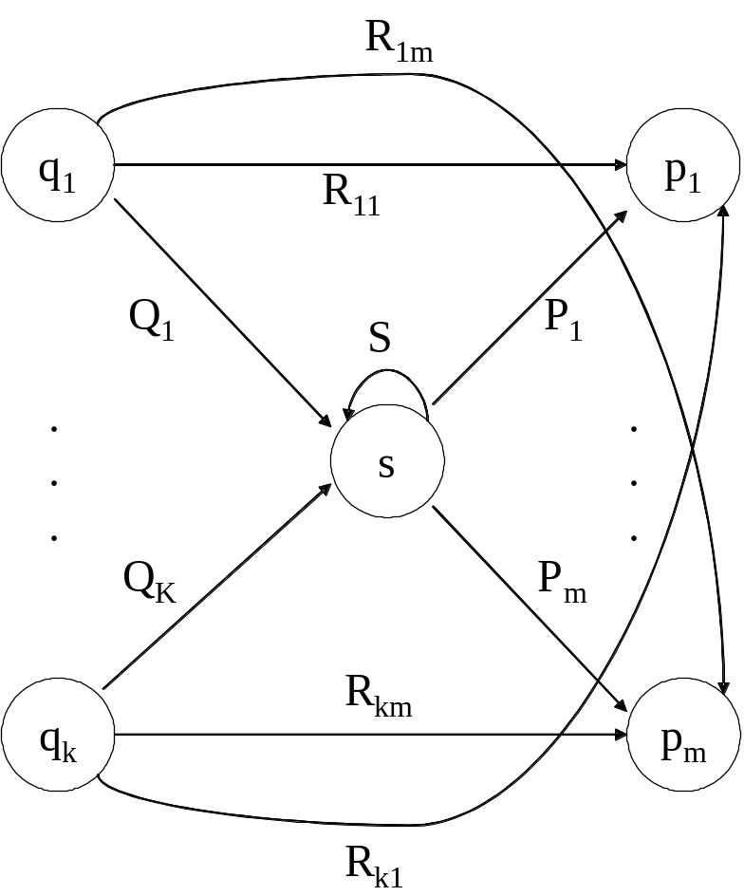
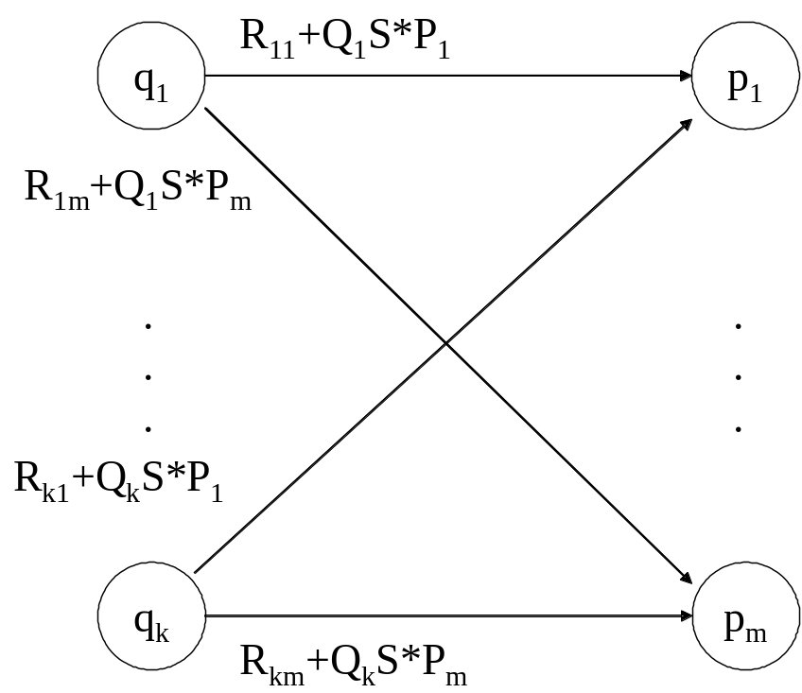
State Elimination
Consider the figure below, which shows a generic state s about to be eliminated. The labels on all edges are regular expressions.
To remove s, we must make labels from each q_{i} to p₁ up to p_{m} that include the paths we could have made through s.
Note: q and p may be the same state!

Slide 11
DFA to RE via State Elimination (1)
Starting with intermediate states and then moving to accepting states, apply the state elimination process to produce an equivalent automaton with regular expression labels on the edges.
  The result will be a one or two state automaton with a start state and accepting state.

Slide 12
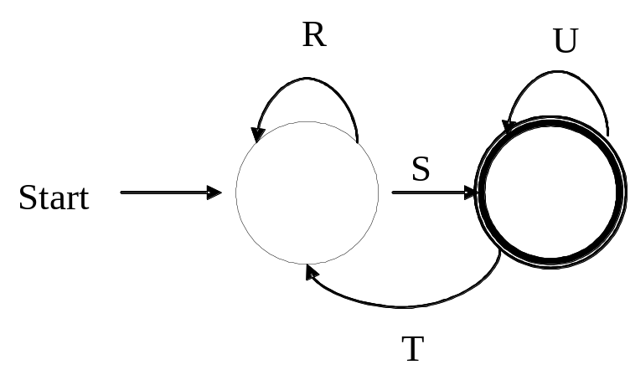
DFA to RE State Elimination (2)
If the two states are different, we will have an automaton that looks like the following:
We can describe this automaton as: (R+SU*T)*SU*

Slide 13
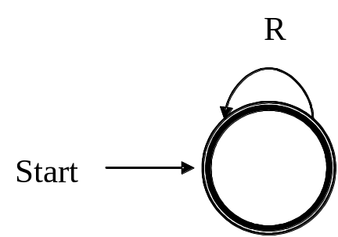
DFA to RE State Elimination (3)
If the start state is also an accepting state, then we must also perform a state elimination from the original automaton that gets rid of every state but the start state. This leaves the following:
We can describe this automaton as simply R*.

Slide 14
DFA to RE State Elimination (4)
If there are n accepting states, we must repeat the above steps for each accepting states to get n different regular expressions, R₁, R₂, … R_{n}. For each repeat we turn any other accepting state to non-accepting. The desired regular expression for the automaton is then the union of each of the n regular expressions: R₁∪ R₂… ∪ R_{N}

Slide 15
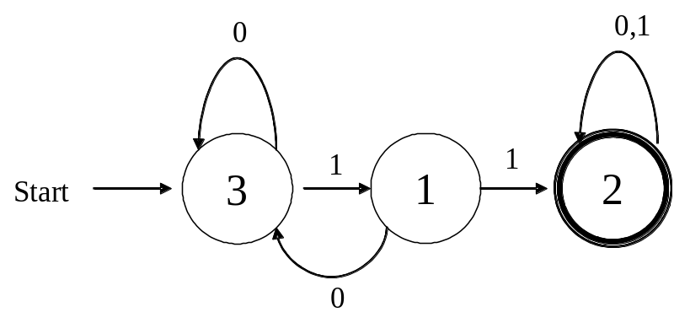
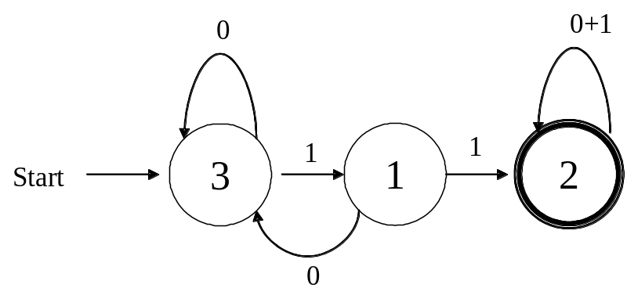
DFA→RE Example
Convert the following to a RE
First convert the edges to RE’s:

Slide 16
DFA → RE Example (2)
0
0+1
Eliminate State 1:
To:
3
1
1
1
2
Start
0
0+10
0+1
Note edge from 3→3
3
11
2
Start
Answer: (0+10)*11(0+1)*

Slide 17
Second Example
Automata that accepts even number of 1’s
Eliminate state 2:
0
0
0
1
1
2
1
3
Start
1
0
0+10*1
1
10*1
3
Start

Slide 18
Second Example (2)
0
0+10*1
1
10*1
3
Start
Two accepting states, turn off state 3 first
0
0+10*1
1
10*1
3
Start
This is just 0*; can ignore going to state 3 since we would “die”

Slide 19
Second Example (3)
0
0+10*1
1
10*1
3
Start
Turn off state 1 second:
0
0+10*1
1
10*1
3
This is just 0*10*1(0+10*1)*
Combine from previous slide to get 0* + 0*10*1(0+10*1)*
Start

Slide 20
Converting a RE to an Automata
We have shown we can convert an automata to a RE. To show equivalence we must also go the other direction, convert a RE to an automaton.
We can do this easiest by converting a RE to an ε-NFA
  Inductive construction
  Start with a simple basis, use that to build more complex parts of the NFA

Slide 21
RE to ε-NFA
Basis:
R=a
a
R=ε
ε
R=Ø
Next slide: More complex RE’s

Slide 22
S
ε
ε
R=S+T
ε
T
ε
S
ε
T
R=ST
ε
ε
S
ε
R=S*
ε

Slide 23
RE to ε-NFA Example
Convert R= (ab+a)* to an NFA
  We proceed in stages, starting from simple elements and working our way up
a
a
b
b
a
ε
b
ab

Slide 24
RE to ε-NFA Example (2)
ab+a
a
ε
b
ε
ε
ε
a
ε
ε
(ab+a)*
a
ε
b
ε
ε
ε
ε
ε
a
ε
ε

Slide 25
What have we shown?
Regular expressions and finite state automata are really two different ways of expressing the same thing.
In some cases you may find it easier to start with one and move to the other
  E.g., the language of an even number of one’s is typically easier to design as a NFA or DFA and then convert it to a RE

Slide 26
Algebraic Laws for RE’s
Just like we have an algebra for arithmetic, we also have an algebra for regular expressions.
  While there are some similarities to arithmetic algebra, it is a bit different with regular expressions.

Slide 27
Algebra for RE’s
Commutative law for union:
  L + M = M + L
Associative law for union:
  (L + M) + N = L + (M + N)
Associative law for concatenation:
  (LM)N = L(MN)
Note that there is no commutative law for concatenation, i.e. LM ≠ ML

Slide 28
Algebra for RE’s (2)
The identity for union is:
  L + Ø = Ø + L = L
The identity for concatenation is:
  Lε = εL = L
The annihilator for concatenation is:
  ØL = LØ = Ø
Left distributive law:
  L(M + N) = LM + LN
Right distributive law:
  (M + N)L = LM + LN
Idempotent law:
  L + L = L

Slide 29
Laws Involving Closure
(L*)* = L*
  i.e. closing an already closed expression does not change the language
Ø* = ε
ε* = ε
L⁺ = LL* = L*L
  more of a definition than a law
L* = L⁺ + ε
L? = ε + L
  more of a definition than a law

Slide 30
Checking a Law
Suppose we are told that the law
  (R + S)* = (R*S*)*
holds for regular expressions. How would we check that this claim is true?
1. Convert the RE’s to DFA’s and minimize the DFA’s to see if they are equivalent (we’ll cover minimization later)
2. We can use the “concretization” test:
  Think of R and S as if they were single symbols, rather than placeholders for languages, i.e., R = {0} and S = {1}.
  Test whether the law holds under the concrete symbols. If so, then this is a true law, and if not then the law is false.

Slide 31
Concretization Test
For our example
  (R + S)* = (R*S*)*
We can substitute 0 for R and 1 for S.
The left side is clearly any sequence of 0's and 1's. The right side also denotes any string of 0's and 1's, since 0 and 1 are each in L(0*1*).

Slide 32
Concretization Test
NOTE: extensions of the test beyond regular expressions may fail.
Consider the “law” L ∩ M ∩ N = L ∩ M.
This is clearly false
  Let L=M={a} and N=Ø. {a} ≠ Ø.
  But if L={a} and M = {b} and N={c} then
  L∩M does equal L ∩ M ∩ N which is empty.
  The test would say this law is true, but it is not because we are applying the test beyond regular expressions.
We’ll see soon various languages that do not have corresponding regular expressions.

